Slide 1
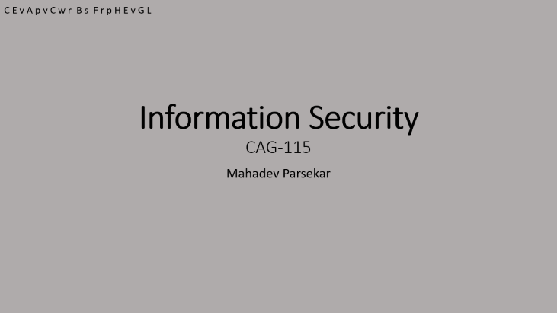
Lecture 1

Slide 2
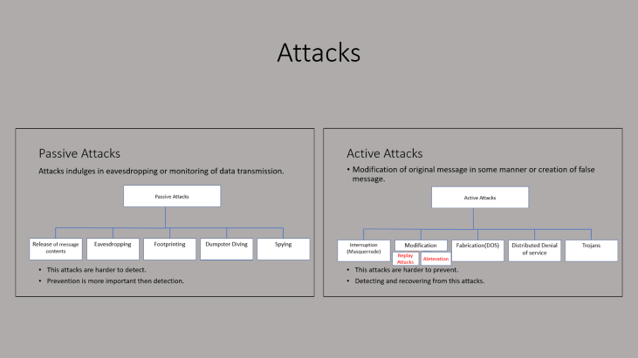
Lecture 2

Slide 3
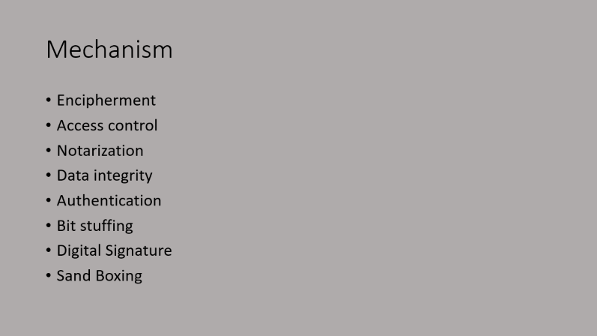
Lecture 2

Slide 4
Information Security CAG-115
C E v A p v C w r B s F r p H E v G L
Mahadev Parsekar

Slide 5
Course Aim
C E v A p v C w r B s F r p H E v G L
Learn Information assurance as practiced in computer operating systems, distributed systems, networks and representative applications.
Learn Cryptography and key encryption techniques used today.
Comprehend relevant security parameters in the internet, web, databases and application.

Slide 6
Security
C E v A p v C w r B s F r p H E v G L
What is Security?
Information Security refers to the processes and methodologies which are designed and implemented to protect print, electronic, or any other form of confidential, private and sensitive information or data from unauthorized access, use, misuse, disclosure, destruction, modification, or disruption

Slide 7
Principles of Security
C E v A p v C w r B s F r p H E v G L
Confidentiality
Authentication
Integrity
Non-Repudiation
Access Control
Availability

Slide 8
Confidentiality
C E v A p v C w r B s F r p H E v G L
Sender and recipient has access to the content of the message.
Confidential
Alice
Bob
Candice

Slide 9
Authentication
C E v A p v C w r B s F r p H E v G L
Prove your identity
Request
Alice
Bob
Response
Candice

Slide 10
Integrity
C E v A p v C w r B s F r p H E v G L
Data is not modified before it reaches its intended receiver.
0
100
Alice
Bob
1000
Candice

Slide 11
Non-Repudiation
C E v A p v C w r B s F r p H E v G L
Assurance that someone cannot deny the validity of something
Denies
Request
Alice
Bob
Token
Request
Alice
Bob

Slide 12
Access Control
C E v A p v C w r B s F r p H E v G L
What information to be shown to which user
Admin Panel
General Info
Alice
Bob

Slide 13
Availability
C E v A p v C w r B s F r p H E v G L
Resource/infrastructure/information should be available to the users at all times.
Information
Alice
Candice

Slide 14
How policies models were broken.
C E v A p v C w r B s F r p H E v G L
Recovery Policy
Sarah Pallin yahoo hack
Matt Honan
Notes:
https://en.wikipedia.org/wiki/Sarah_Palin_email_hack
https://www.wired.com/2012/08/apple-amazon-mat-honan-hacking/

Slide 15
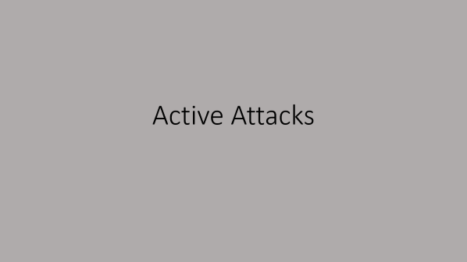
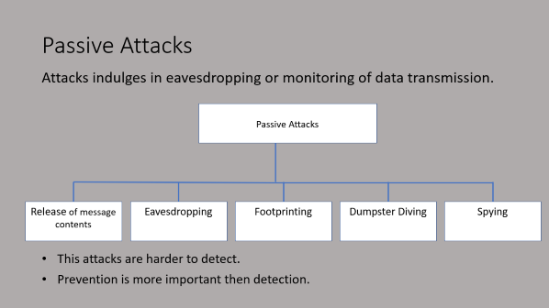
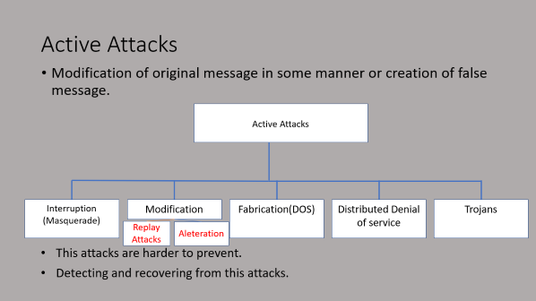
Attacks

Slide 16
Passive Attacks
Attacks indulges in eavesdropping or monitoring of data transmission.
Passive Attacks
Release of message contents
Eavesdropping
Eavesdropping
Footprinting
Dupmster Diving
Dumpster Diving
Spying
This attacks are harder to detect.
Prevention is more important then detection.

Slide 17
How to avoid passive attacks
Encrypt data
Symmetric encryption
Asymmetric -- or public key – encryption
Keep sensitive information private
Saving Hashes of user sensitive data

Slide 18
Active Attacks
Modification of original message in some manner or creation of false message.
Active Attacks
Interruption
(Masquerade)
Eavesdropping
Modification
Fabrication(DOS)
Distributed Denial of service
Trojans
Replay Attacks
Aleteration
This attacks are harder to prevent.
Detecting and recovering from this attacks.

Slide 19
Buffer Overflow
#include<stdio.h>
int read_req(void){
char buf[128];
int i;
gets(buf);
i = atoi(buf);
return i;
}
int main(int ac, char **args){
int x = read_req();
printf(“x=%d\n”, x);
}

Slide 20
How to avoid passive attacks
Firewalls
Fix Configuration
People awareness
Identification of problems
White Hats
Blue Team
Red Team

Slide 21
Practical Side of Attacks
Attacks in practice
Eavesdropping
Application level attack
Network

Slide 22
Threats and Attacks to Information Security
Virus
Worms
Trojan Horse
Spam
Phishing
Ransomware

Slide 23
Mechanism
Encipherment
Access control
Notarization
Data integrity
Authentication
Bit stuffing
Digital Signature
Sand Boxing

Slide 24
Encipherment
Security mechanism deals with hiding and covering of data which helps data to become confidential.
Achieved using techniques of cryptography and encipherment.
Helps in keeping check of confidentiality

Slide 25
Access Control
Play a key role in identity and access management (IAM)
“Subjects are usually people or groups. Objects are usually files or directories. The key is, subjects access objects, and so access controls regulate how subjects access objects.”
-Greg Scott.
Notes:
The Role of Access Control in Information Security - Hashed Out by The SSL Store™

Slide 26
Notarization
This security mechanism involves use of trusted third party in communication.
This mediator keeps record of requests made by sender to receiver for later denied.

Slide 27
Data integrity
This security mechanism is used by appending value to data to which is created by data itself

Slide 28
Authentication
This security mechanism deals with identity to be known in communication

Slide 29
Bit stuffing
This security mechanism is used to add some extra bits into data which is being transmitted

Slide 30
Digital Signature
This security mechanism is achieved by adding digital data that is not visible to eyes
This mechanism is used to preserve data which is not more confidential but sender’s identity is to be notified.

Slide 31
Data Integrity
Accuracy and completeness of data
Security controls focused on integrity are designed to prevent data from being modified or misused by an unauthorized party
Security Controls
Encryption
User access controls
Version control
Backup and recovery procedures
Error detection software

Slide 32
Methods to detect Data intergrity
Single Parity Check
If the number of 1s bits is odd, then parity bit 1 is appended and if the number of 1s bits is even, then parity bit 0 is appended at the end of the data unit
Two-Dimensional Parity Check
In Two-Dimensional Parity check, a block of bits is divided into rows, and the redundant row of bits is added to the whole block.
Checksum
Cyclic Redundancy Check (CRC)

Slide 33
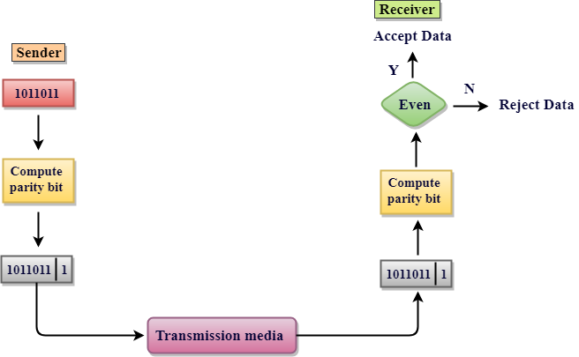
Single Parity Check
Even Parity
00000010 | 1
10010010 | 1
Odd Parity
00000011 | 1
10010010 | 0

Slide 34
Two-Dimensional Parity Check
11001110 | 1
10111010 | 1
01110010 | 0
01010010 | 1
____________
01010101 | 1

Slide 35
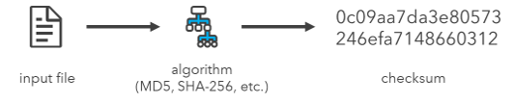
Checksum
Notes:
How To: Verify an Esri download using the checksum
Computer Network | Error Detection - javatpoint

Slide 36
Cyclic Redundancy Check (CRC)
XOR
A | B | A XOR B
0 | 0 | 0
1 | 0 | 1
0 | 1 | 1
1 | 1 | 0

Slide 37
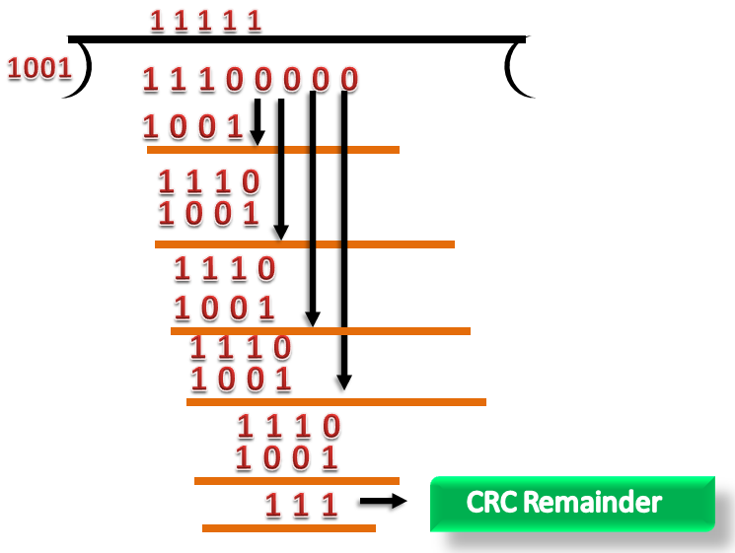
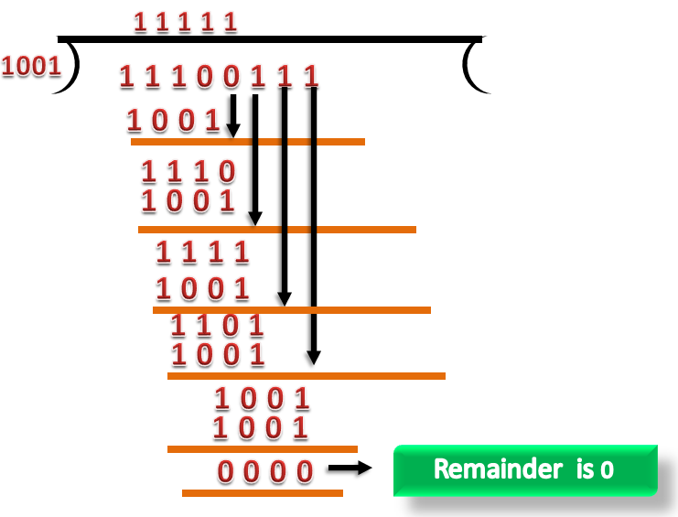
Cyclic Redundancy Check (CRC)

Slide 38
Other Methods used
Encryption
User access controls
Version control
Backup and recovery procedures
Error detection software

Slide 39
Digital Signature
Digital signature is a cryptographic value that is calculated from the data and a secret key known only by the signer
Notes:
https://www.tutorialspoint.com/cryptography/cryptography_digital_signatures.htm#:~:text=Digital%20signature%20is%20a%20cryptographic,the%20origination%20of%20that%20message.
https://www.tutorialspoint.com/cryptography/cryptography_digital_signatures.htm

Slide 40
Signing
Sender
Receiver
Hashing Function
Data
Signers
Private
Key
Equal
Data
Hashing Function
Signature
Algorithm
Signature
Verification Algorithm
Hash
Hash
Signers
Private
Key

Slide 41
Hashing Algorithm which can be Used in digital Signature
Secure Hash Algorithm-1 (SHA-1), the Secure Hashing Algorithm-2 family (SHA-2 and SHA-256)
Notes:
https://www.cisa.gov/uscert/ncas/tips/ST04-018#:~:text=Some%20of%20the%20more%20popular,Message%20Digest%205%20(MD5).&text=Ensure%20integrity%20by%20creating%20a,using%20the%20sender's%20private%20key.
https://qvault.io/cryptography/how-sha-2-works-step-by-step-sha-256/

Slide 42
Importance of Digital Signature
Message authentication
Data Integrity
Non-repudiation

Slide 43
Encryption with Digital Signature
Sender
Receiver
Verify Signature
With Sender Public
key
Data
Encryption Using
Receivers Public key
Encrypted Data
+
Digital Signature
Valid?
Hashing Function
Retrieve Data using
Receivers private key
Hash
Digital Signature
With Sender Private key
Data

Slide 44
Encryption Algorithm which can be Used
RSA
Ron Rivest, Adi Shamir, and Leonard Adleman.(1970)

Slide 45
Authentication
process for establishing your identity to gain access to a system
Typically Two steps
Identify Yourself(email id, phone number, mid, uid)
Prove your identity(passwords)
MFA(Multi factor authentication)
OTP, finger print, iris scan

Slide 46
Ways to Authenticate
Something you are
Scanned Body Part
Something You have
OTPs on mobile, Token only sent previously to authenticated devices.
Something You know
Pin, Password, passphrase

